Slide 1
Use Data Analysis for
Car Price Prediction
Group members:
Yongqi Zhao
/Taiwo Alare
/Hongcheng Qian

Slide 2
Initial idea: When we are going to purchase a used car, how can we apply what we learned on the class to make the best deal of our feature car?
Goal: Compare different linear regression models to find the best accuracy, and predict the price of cars with given variable value.

Slide 3

How to reach it
Python Library:
Numpy
Pandas
Matplotlib
Regression Models:
Linear Regression
Decision Tree Regression
Random Forest Regression

Slide 4
What did we do? (4 Parts)
Read Dataset
Loading the Dataset which we want to gain the information from.
Visualization
Give us a more directly way to know more about the information from the data
Prepare Data
Dummy and split the data informations
Apply to Regression Model

Slide 5
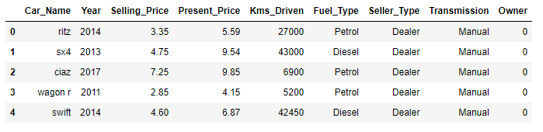
Read Dataset
We first read the file and get detailed vehicle information.
Use .head() method to show the name of each column and first 5 rows to have a overall understanding of the dataset.
–.isnull() shows dataset has no missing value, which means we can start to analysis

Slide 6
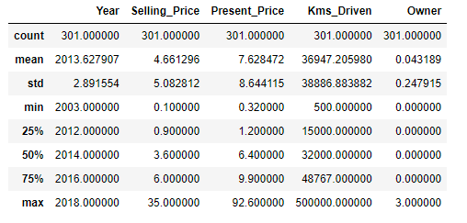
We make describe to the datas.
Now, we know that we have 8 columns * 301 rows dataset of cars. Each columns represent the properties of cars:
Name;
Year;
Selling price;
Present price;
Kms driven(mileage);
fuel type;
Transmission;
owners.

Slide 7
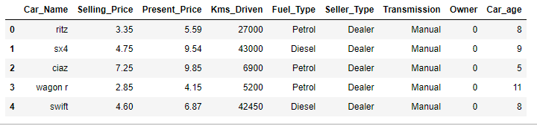
The age of car is also important to know when we are buying a used car, thus we computed the cars’ age to replace the year of car and adding these information inside the chart. It helps us easier and clearer to read in later analysis.

Slide 8
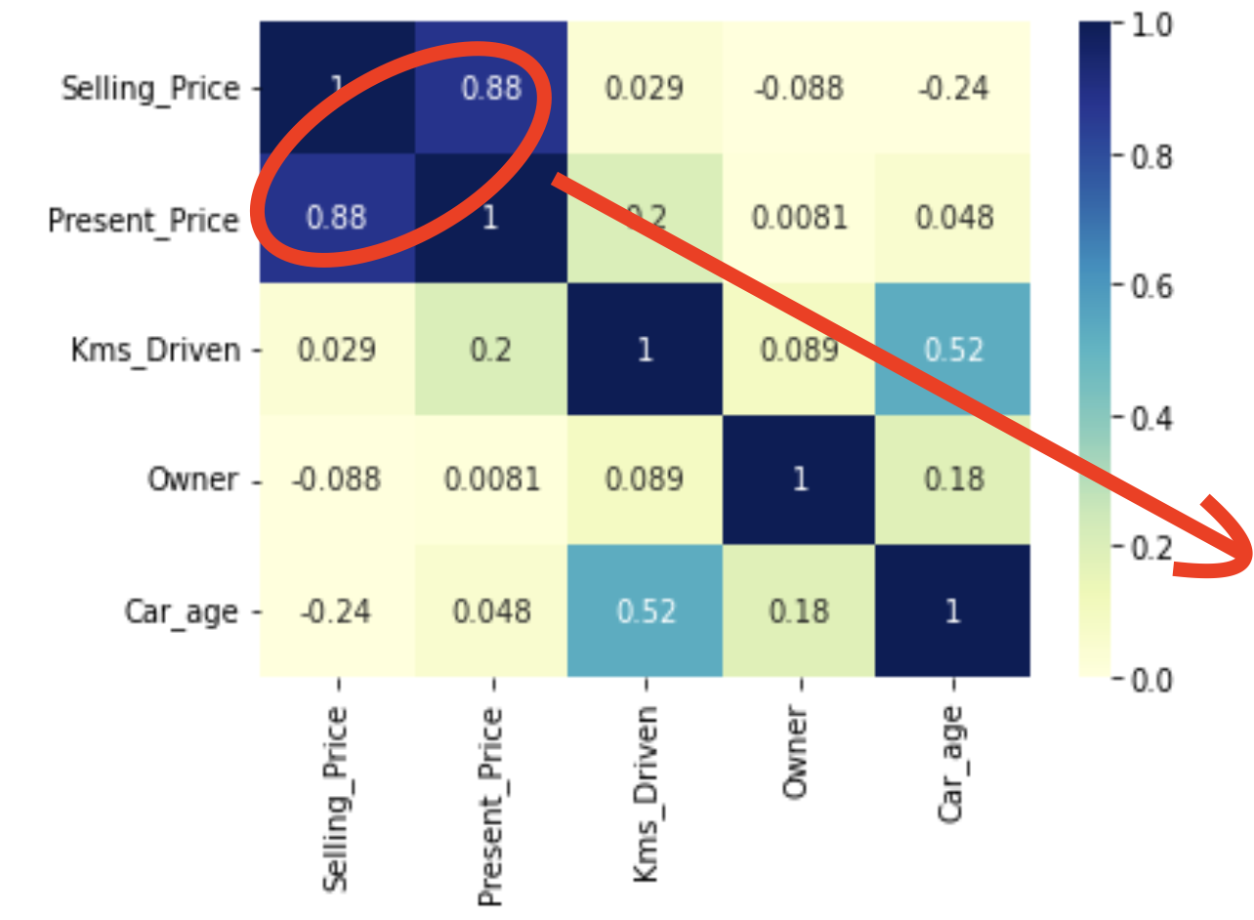
Visualization
Multi-variable correlation
In order to know more about the relation between variables, we find the pairwise correlation of all columns in the dataframe and presented by heatmap
strong relationship
Notes:
A heatmap is a graphical representation of data where each value of a matrix is represented as a color.
We can see the selling price and present price hava the highest correlation value -- 0.88.
It means two variables have a strong relationship with each other

Slide 9
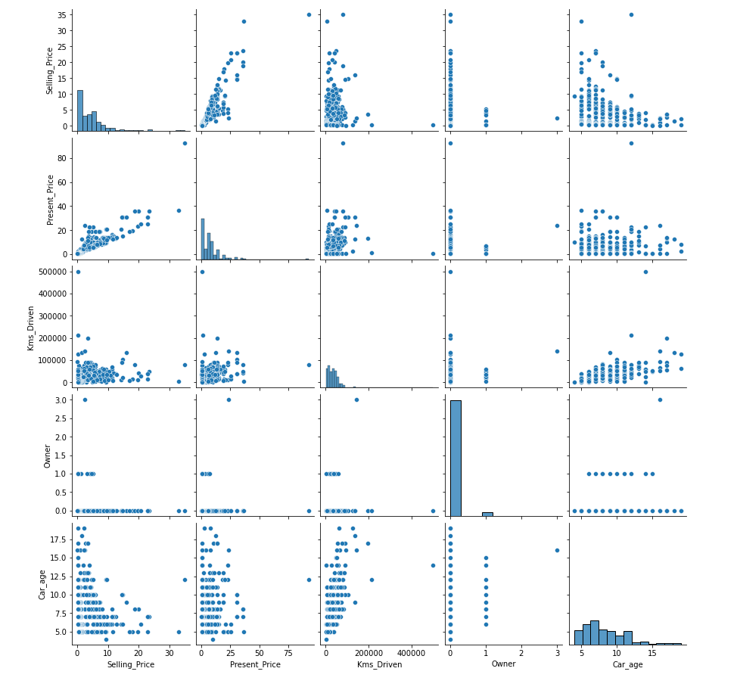
Furthermore, we use sns.pairplot( ) in order to have a more visualized correlation between variables.
Notes:
A pairplot plot a pairwise relationships in a dataset. The pairplot function creates a grid of Axes such that each variable in data will by shared in the y-axis across a single row and in the x-axis across a single column. As you can see on the screen, it’s pretty straightforward to demonstrate the linear relationship between selling price and present price

Slide 10
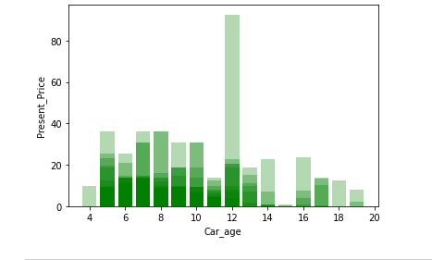
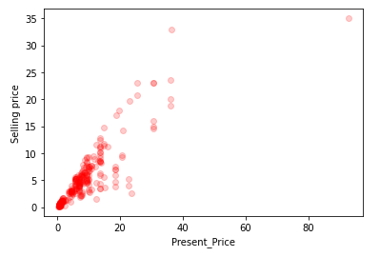
More beyond…
Single-variable correlation
Relationship between Present Price and Vehicle Age.
Relationship between Selling Price and Present Price.

Slide 11
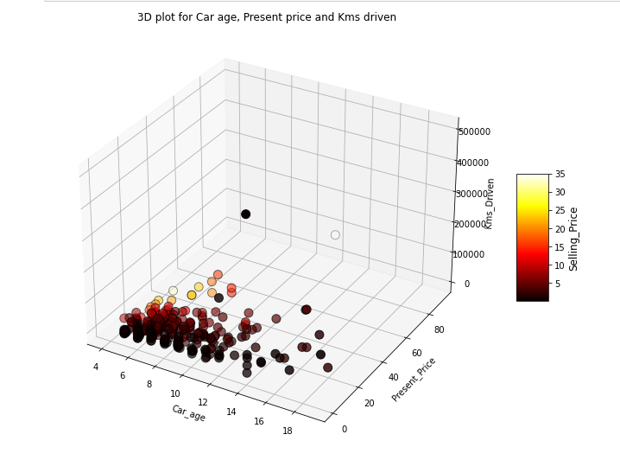
3D plot for Car age, Present price and Kms driven
Notes:
If we 3D plot critic features that effect selling price, we can see most of the cars accumulate around age 4-10, low present price and low kms driven. Now it’s time to apply regression models.

Slide 12
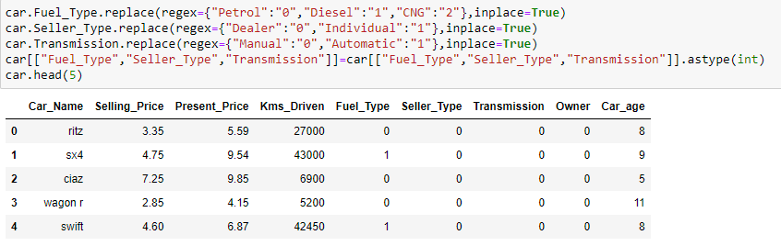
Prepare Data
Data transformation refers to converting string variable into int variable so that the algorithms can understand how to operate on them (same as Dummy Variable).
Notes:
Before we apply the model, we need to change our dataframe easy to use.

Slide 13
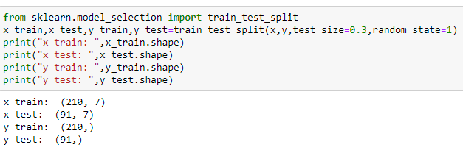
Prepare for model training
In statistics and machine learning we usually split our data into two subsets: training data and testing data (and sometimes to three: train, validate and test), and fit our model on the train data, in order to make predictions on the test data.

Slide 14
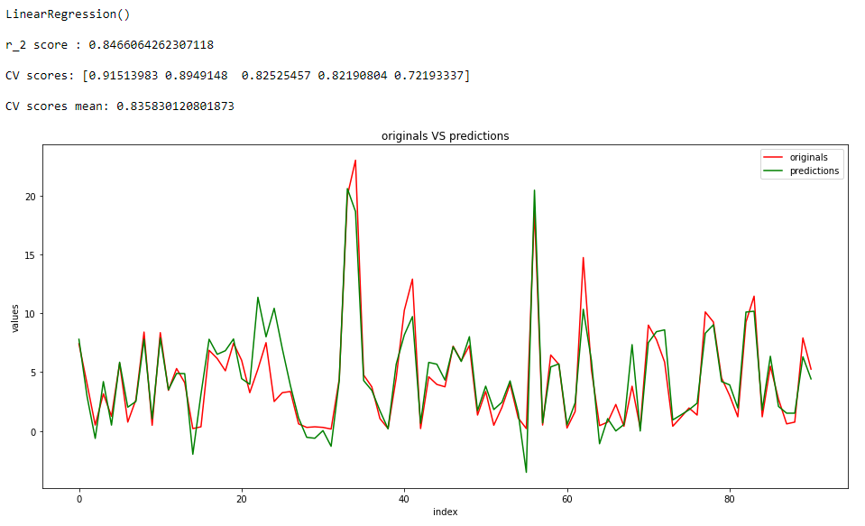
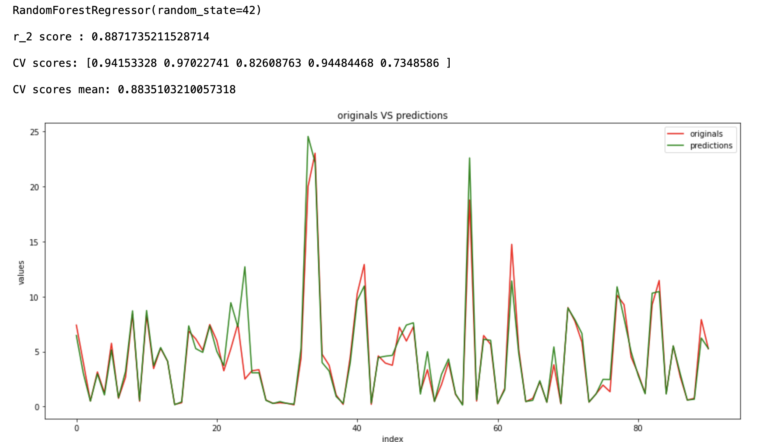
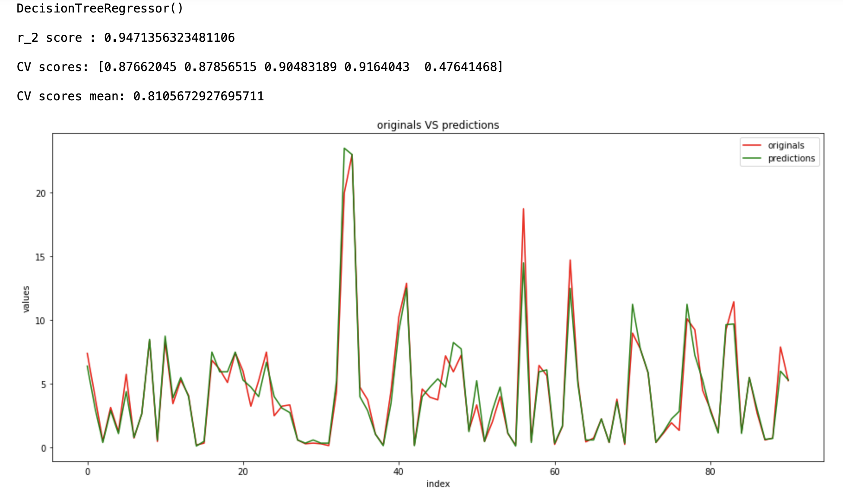
Apply to Regression Model
We used three regression models to train the dataset, and calculated the R-squared and Cross-validation to compare the models.
Also, we compared the plot between predicted and original selling price.
Notes:
Now it’s the time to finally apply the regression model on the training and testing datasets.

Slide 15
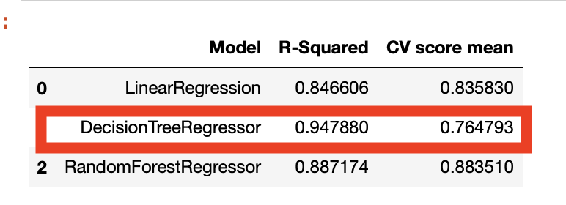
Choose Model
Winner — Decision Tree!!!!
Notes:
We can compare those three generated regression images. The graph of predictions are very similar to the graph of originals.
Also, all those three regression model have a high R-squared value, which indicates that our results are very close to the reality.

Slide 16
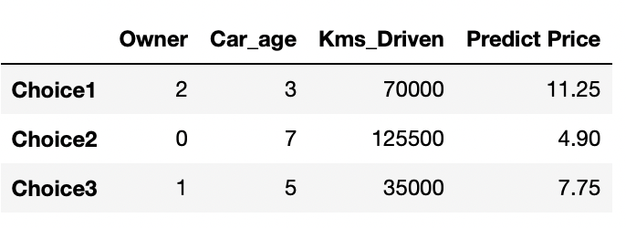
Price Predict upon some given data
Notes:
Lastly, let’s apply the regression model on the testing data. Think about a scenario, you are comparing 3 cars in your wishlist, and you are not sure about if the price that dealer provide are accutare, then luckily you find this price predict tool! By putting the owner info, age of car and kms_driven, it gives you a predict price of those 3 cars. Now you know what are the appropriate price of your dream car.

Slide 17
Conclusion
Present price of a car plays an important role in predicting Selling Price, One increases the other gradually increases. Car age is affecting negatively as older the car lesser the Selling Price. Kms driven is the most correlated variable for the price predicting.

Slide 18
END
Thank you for watching and listening.

